Slide 1
REAL-TIME GENDER DETECTION AND AGE PREDICTION
By-
Bharathvarsh S
Srivishwa P
Surya Narayanaan KC

Slide 2
agenda
Why do we need Gender Detection
Key features of Gender Detection
​Technologies Used
Architecture
Features of our Project
Limitations
​Future Scope

Slide 3
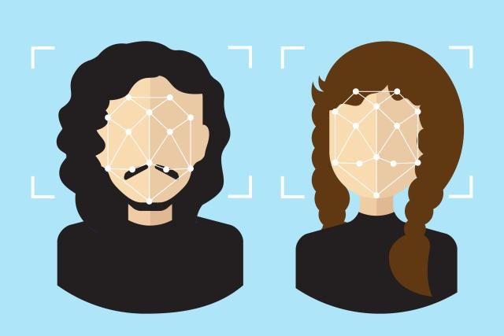
Why do we need Gender Detection?
In today's digital age, social media has seamlessly woven itself into the fabric of our lives, enabling connections across borders and offering a platform for individuals to share their thoughts, experiences, and moments. However, as social media's popularity has surged, so too has the alarming issue of spoofing, which has become a formidable problem. Hence, Real-time gender detection is essential for personalized services, enhanced security, and targeted content.

Slide 4
KEY FEATURES OF GENDER DETECTION

Slide 5
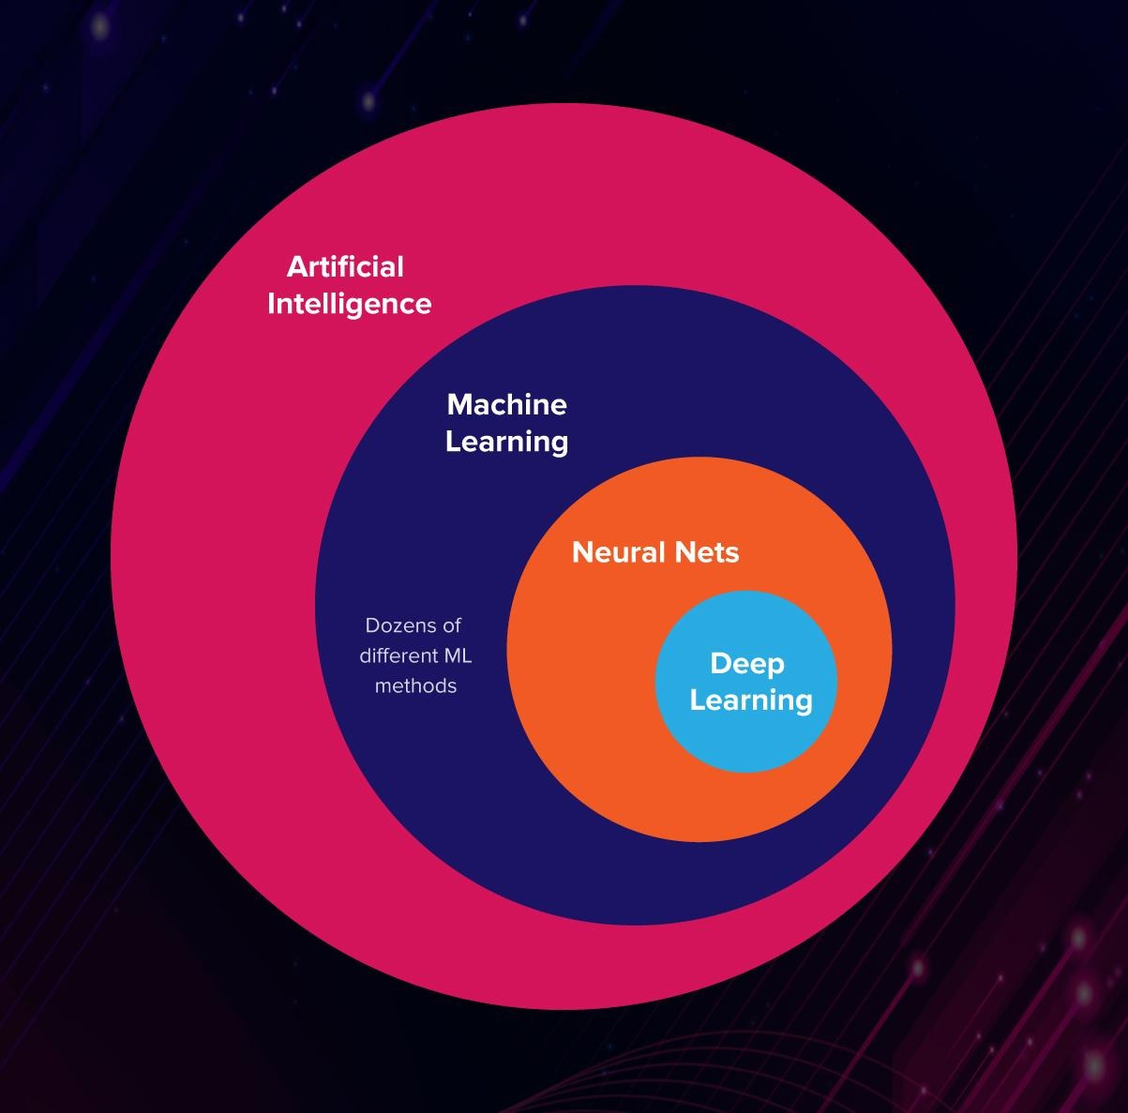
Artficial Intelligence:
AI-powered gender detection and age prediction systems utilize complex algorithms to analyze and interpret patterns in data, enabling accurate predictions.
Adaptability: AI algorithms can adapt and improve over time by learning from new data, enhancing the precision of gender and age predictions.
Cognitive Capabilities: AI allows the system to mimic human cognitive functions, enabling it to process vast amounts of data and make predictions swiftly and efficiently.

Slide 6
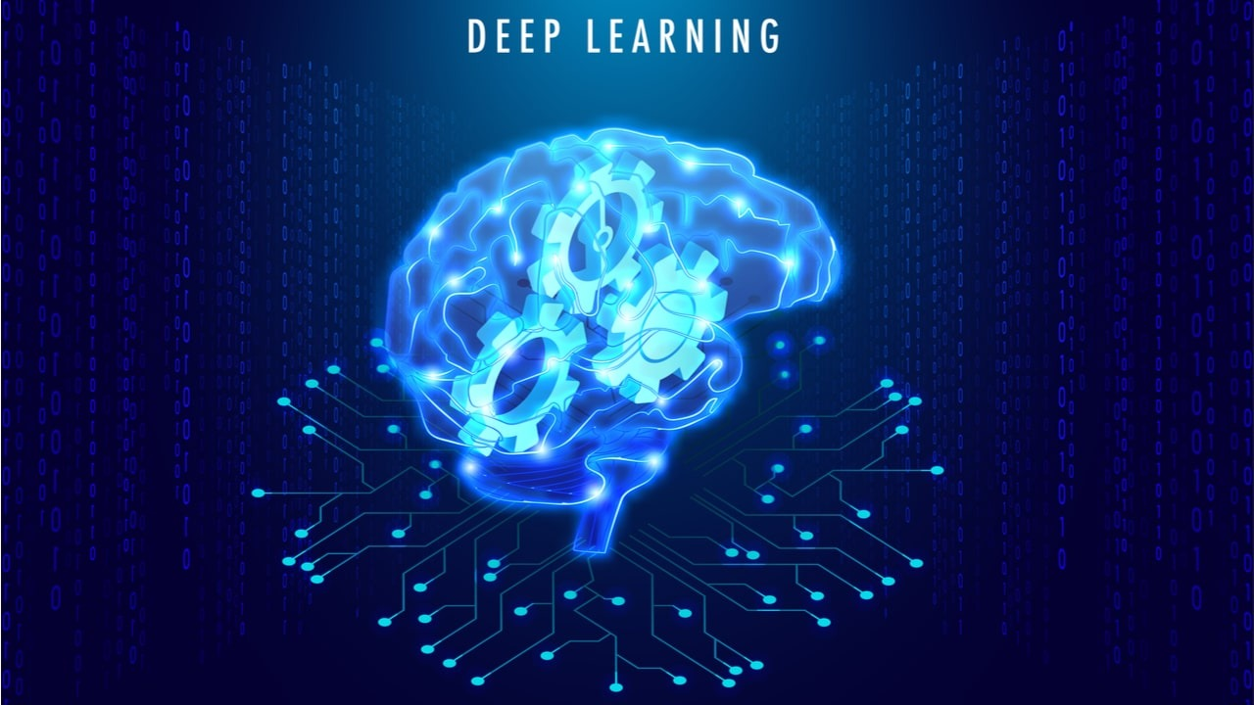
Deep Learning:
Neural Networks: Deep learning models, specifically neural networks, can automatically learn hierarchical features from data, allowing for nuanced understanding of facial features and other relevant characteristics.
Feature Extraction: Deep learning techniques excel at automatically extracting intricate features from images, ensuring that subtle facial cues are captured for accurate gender and age predictions.
Complex Data Representation: Deep learning models can create complex internal representations of data, enabling them to handle intricate patterns and variations in facial images for precise predictions.

Slide 7




Technologies used
python
FASTAPI
opencv​
SQLITE DB​

Slide 8
ARCHITECTURE OF REAL-TIME GENDER DETECTION AND AGE PREDICTION

Slide 9
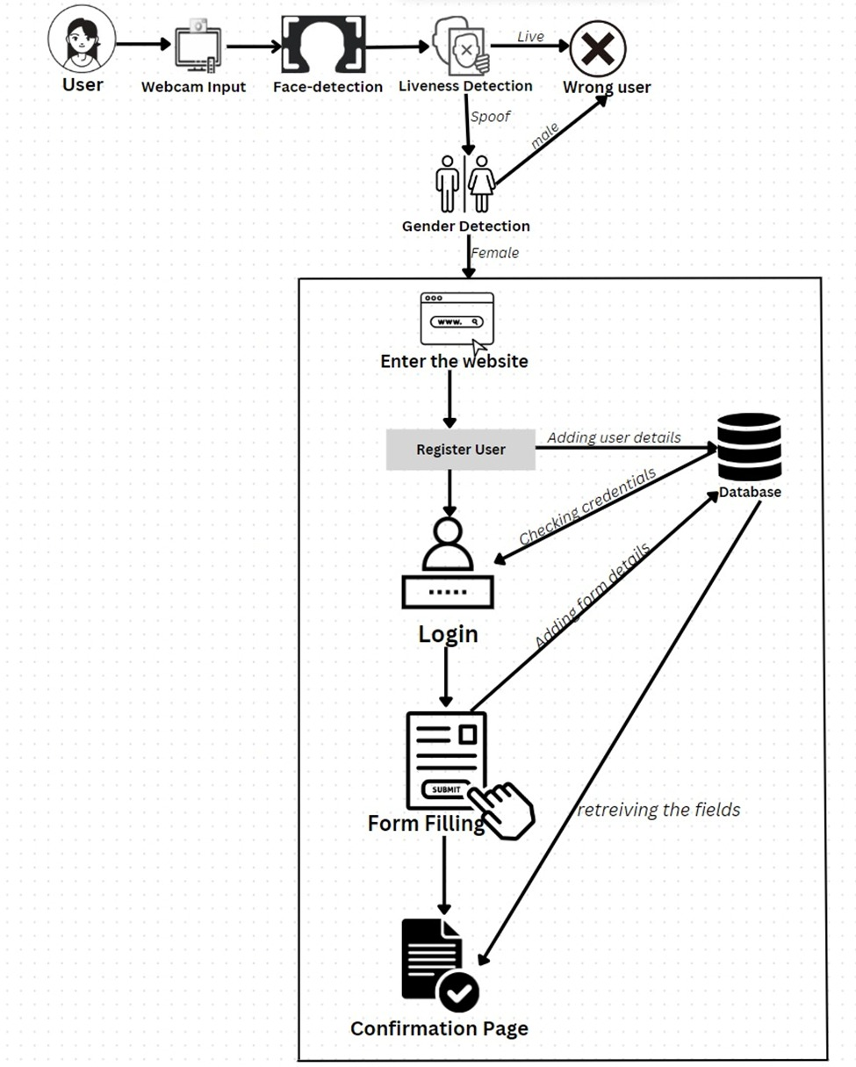

Slide 10



ANTI-SPOOF DETECTION
Spoofing attacks pose a significant challenge to facial verification systems as they attempt to deceive the system by presenting a fake image of a face.
The goal of facial anti-spoofing is to prevent false facial verification by identifying and differentiating real faces from photos, videos, masks, or other substitutes used by attackers.
Implementation of Liveness Detection:
After detecting a face in a frame, the code applies face anti-spoofing using pre-trained models.
The anti-spoofing models analyse the frames to determine whether the face is real or fake

Slide 11
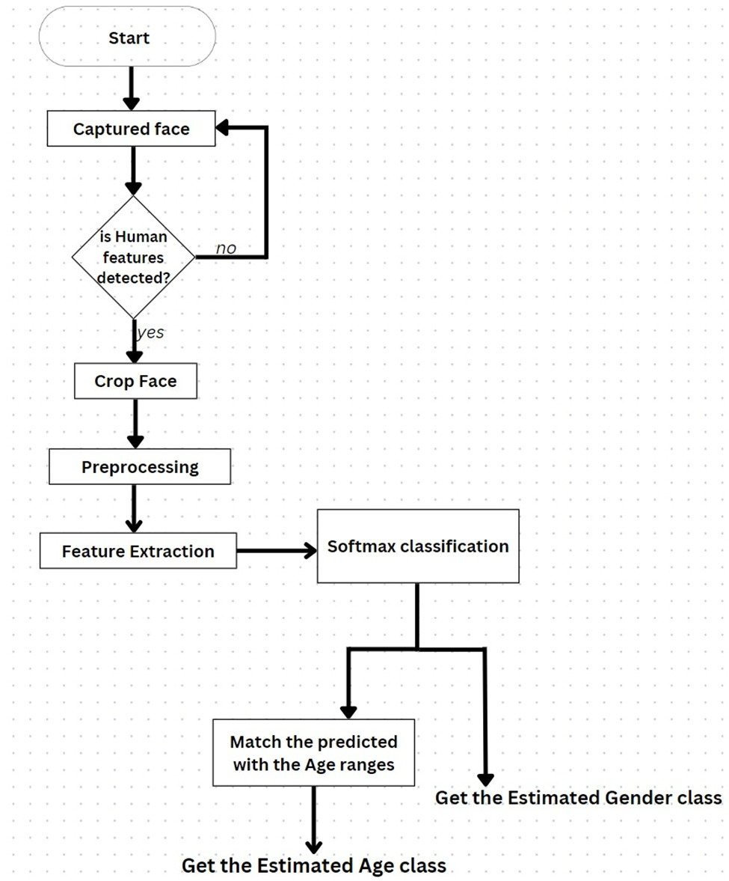
IMPLEMENTATION OF GENDER DETECTION

Slide 12


USER INTERFACE
Our website is a testament to our team's dedication and expertise, providing an impactful digital presence that aligns with our brand identity and delivers value to our users.
The website utilizes the machine learning code that leverages the web camera available on the user's system to perform a series of verifications.
Login page
Form page

Slide 13
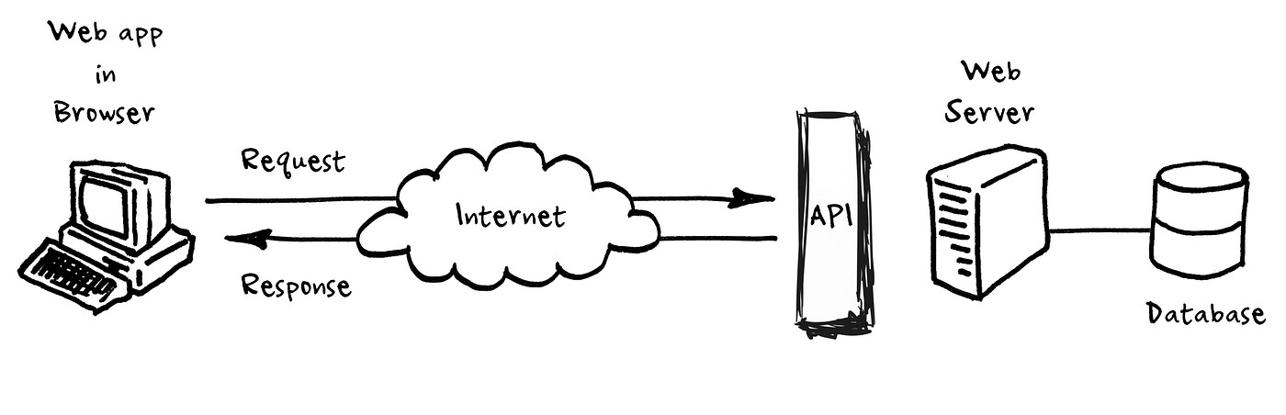
Python backend
Core backend written in Python(OpenCV and FastAPI frameworks)
Processes user commands, manages databases (SQLite), and controls various functionalities.

Slide 14
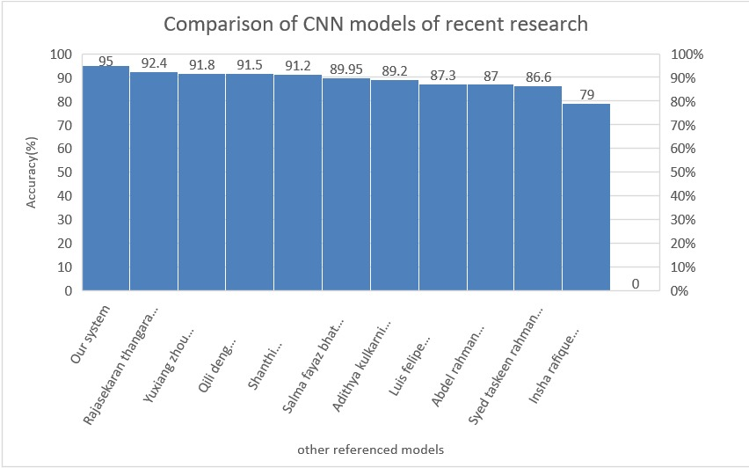


Analysis
Our custom CNN architecture demonstrably excels when compared to the models mentioned in the report, notably achieving an impressive accuracy rate of 95%.

Slide 15
limitations
Accuracy Discrepancies: Gender detection can sometimes yield inaccurate results, especially when working with diverse and less-represented demographics. Variations in age, race, or personal expression can make accurate classification challenging.
Privacy Concerns: Real-time gender detection systems can raise privacy issues, as they involve processing live video or images. This can be perceived as invasive, particularly when used in public spaces without consent.
Bias and Fairness: Gender detection models can perpetuate biases present in the training data, leading to misclassifications and reinforcing gender stereotypes. Addressing fairness and bias in these systems is an ongoing challenge.

Slide 16
Future scope
Enhanced Accuracy: Further refinement of the deep learning models and increasing the diversity of the training dataset can boost accuracy, making the system even more reliable.
Multimodal Analysis: Expanding the project to include other biometric features for more comprehensive analysis, such as age, emotions, or identification to create a more versatile system.
Privacy Measures: Implementing privacy features and adhering to data protection regulations to ensure the privacy and consent of individuals when their data is processed
Bias Mitigation: Continued research into addressing biases in gender detection algorithms to ensure fairness and accuracy, particularly among underrepresented groups.

Slide 17
Thank you
PRESENTED BY
Bharathvarsh S
Srivishwa P
Surya Narayanaan KC

